Slide 1
NEWGEN SOFTWARE
Name :- Suyash Singh
College :- University of Petroleum and Energy Studies (UPES)
Designation :- Data Scientist.

Slide 2
DATASET
Dataset have 10 classes and number of total images are:- 3473
Class ADVE have 221 images.
Class Email have 599 images.
Class Form have 431 images.
Class Letter have 567 images.
Class Memo have 620 images.
Class News have 188 images.
Class Note have 201 images.
Class Report have 265 images.
Class Resume have 120 images.
Class Scientific have 261 images.

Slide 3
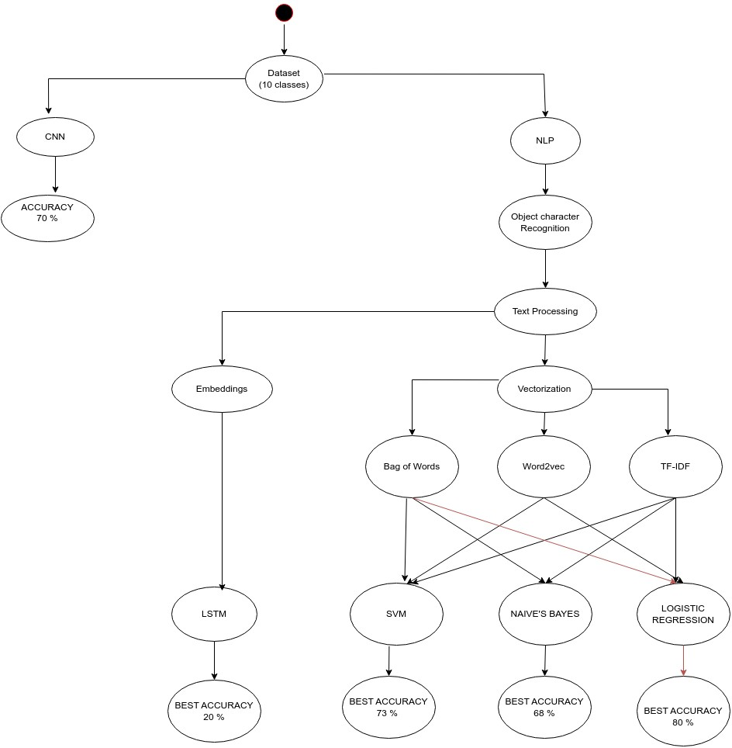
STATE DIAGRAM:-

Slide 4
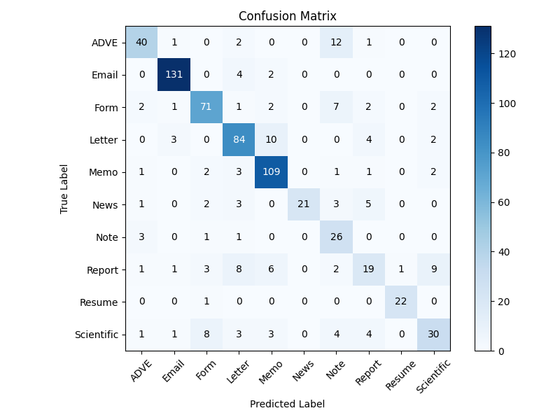
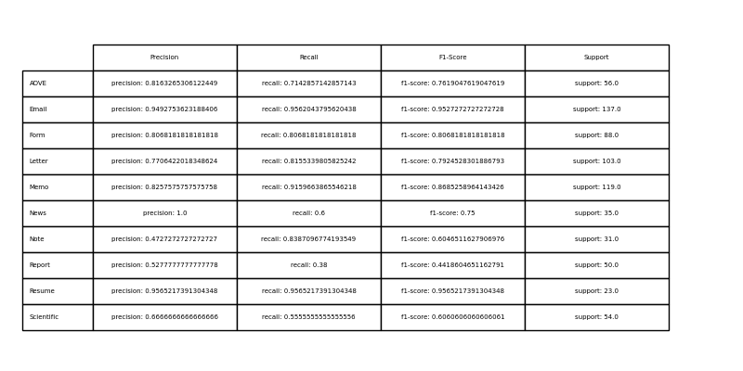
I:- NLP
1:- Logistic-Regression:-
(i) BOW:-
Accuracy: 0.79 Precision: 0.80 Recall: 0.79
Classification Report

Slide 5
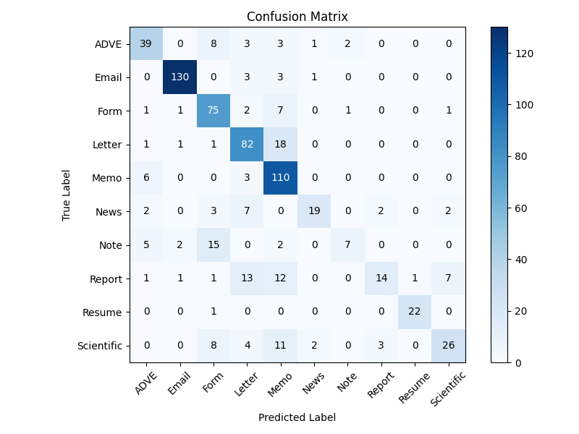
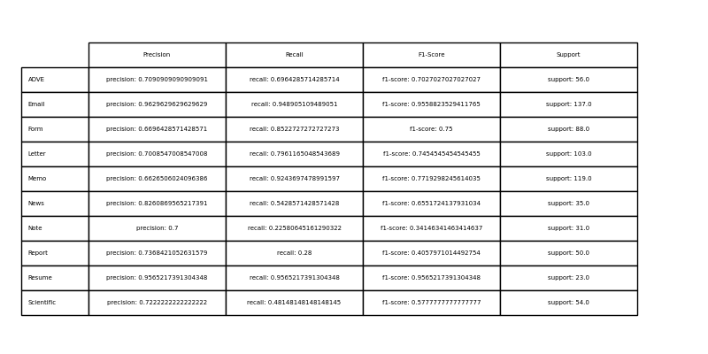
(ii) TF-IDF:-
Accuracy: 0.75 Precision: 0.76 Recall: 0.75
Classification Report

Slide 6
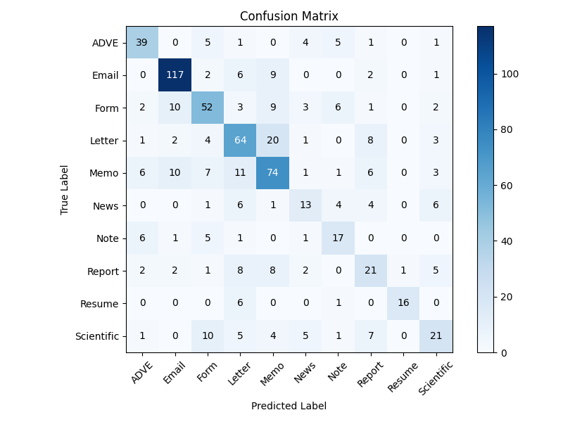
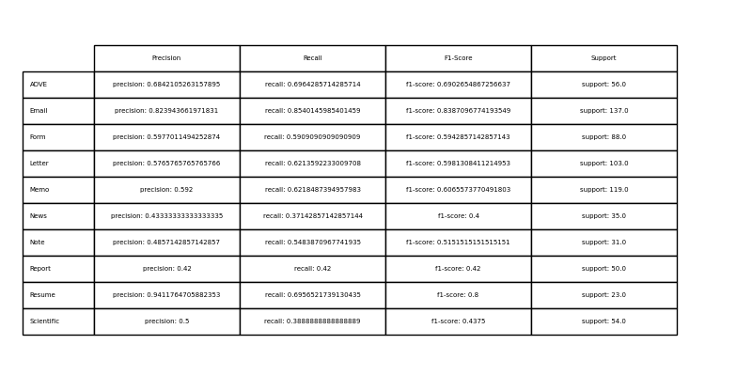
(iii) Word2vec
Accuracy: 0.62 Precision: 0.62 Recall: 0.62
Classification Report

Slide 7
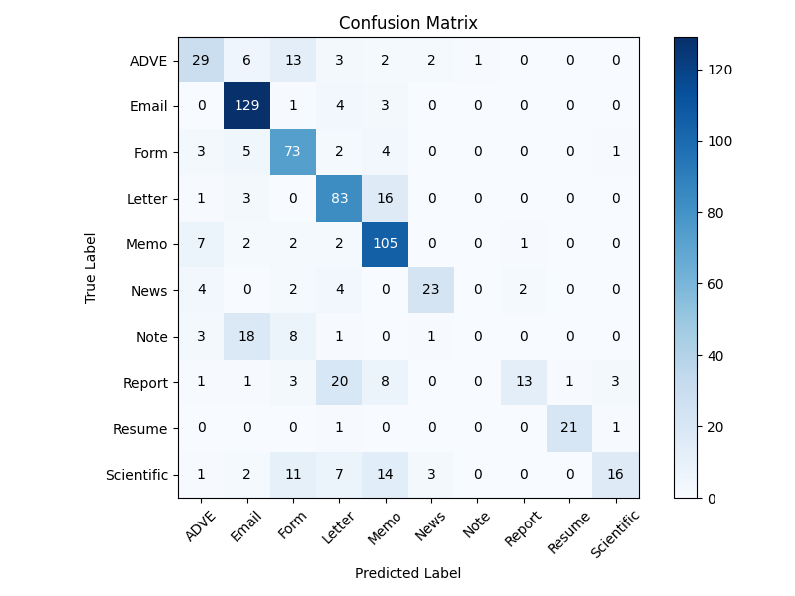
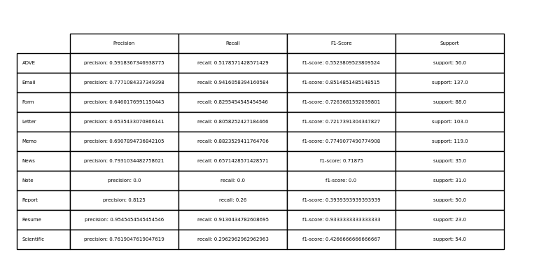
2:- SVM
(i) BOW :-
Accuracy: 0.71 Precision: 0.69 Recall: 0.71
Classification Report

Slide 8
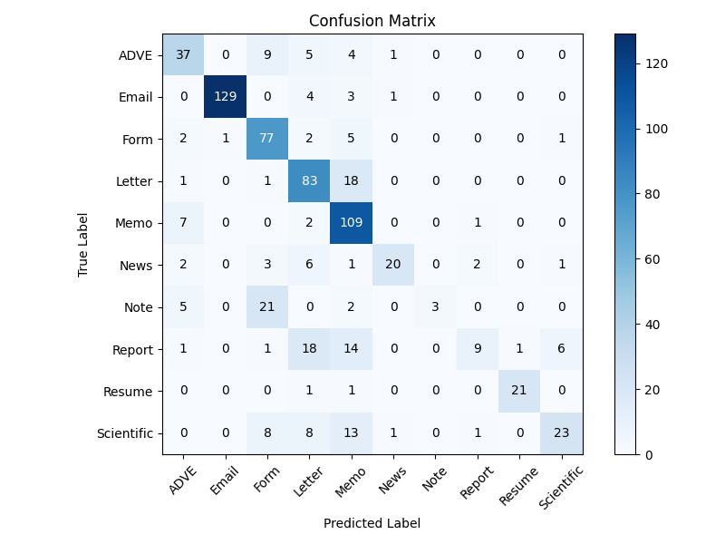
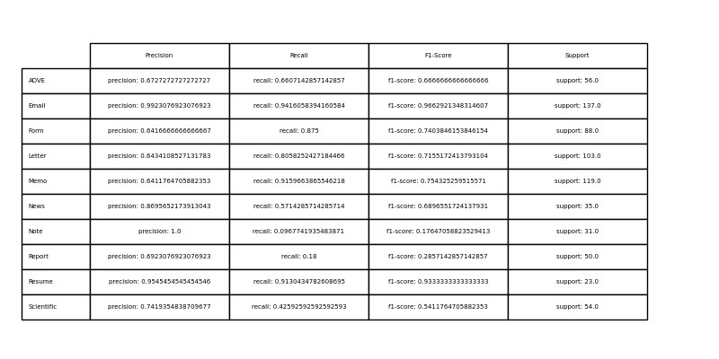
(ii) TF-IDF:-
Accuracy: 0.73 Precision: 0.76 Recall: 0.73
Classification Report

Slide 9
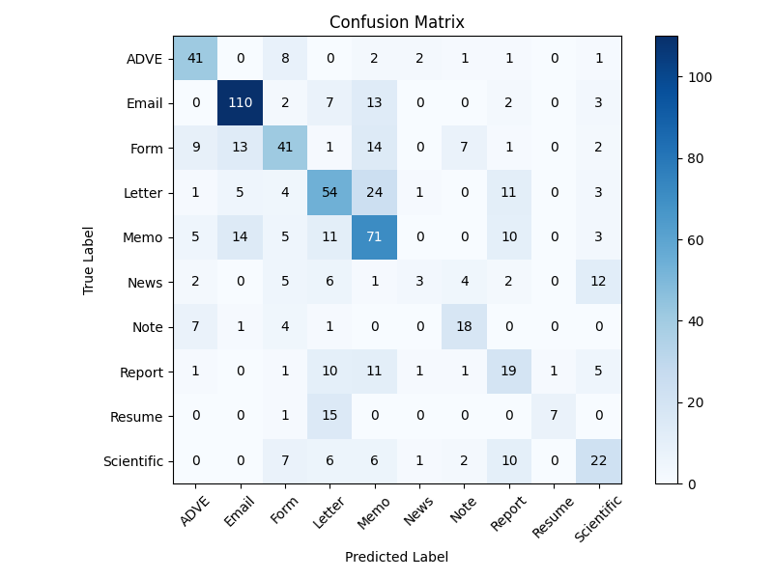
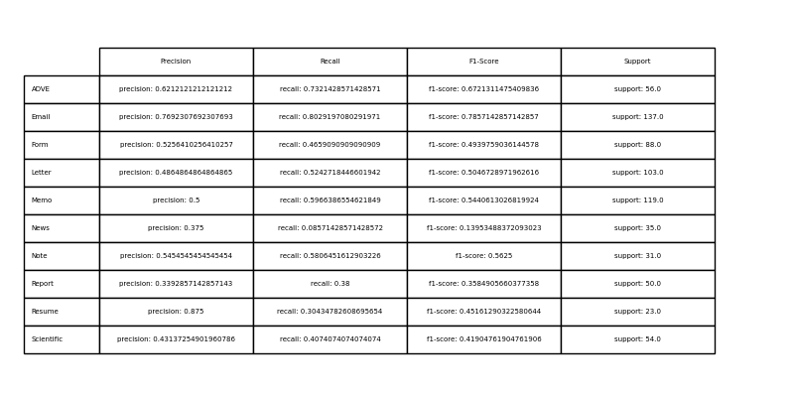
(iii) Word2vec:-
Accuracy: 0.55 Precision: 0.56 Recall: 0.55
Classification Report

Slide 10
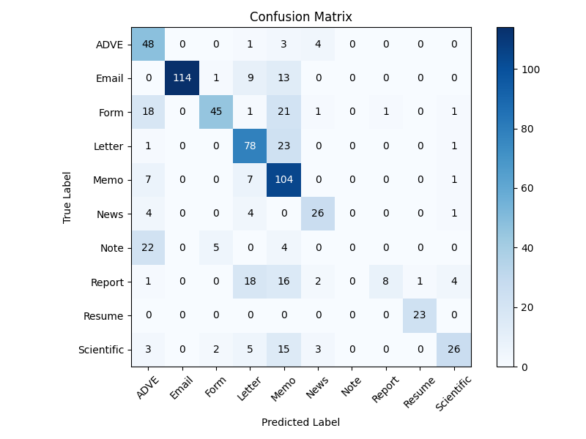
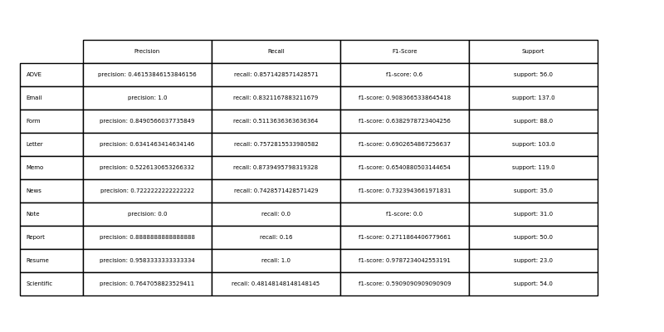
3:- Naïve’s Bayes: -
(i) BOW :-
Accuracy: 0.68 Precision: 0.72 Recall: 0.68
Classification Report

Slide 11
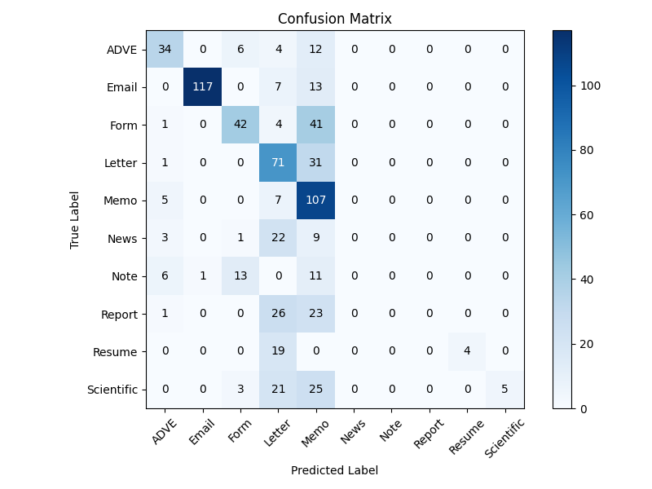
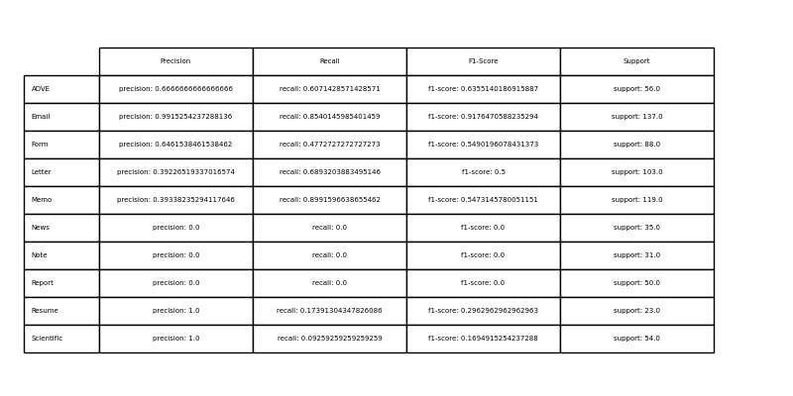
(ii) TF-IDF :-
Accuracy: 0.55 Precision: 0.57 Recall: 0.55
Classification Report

Slide 12
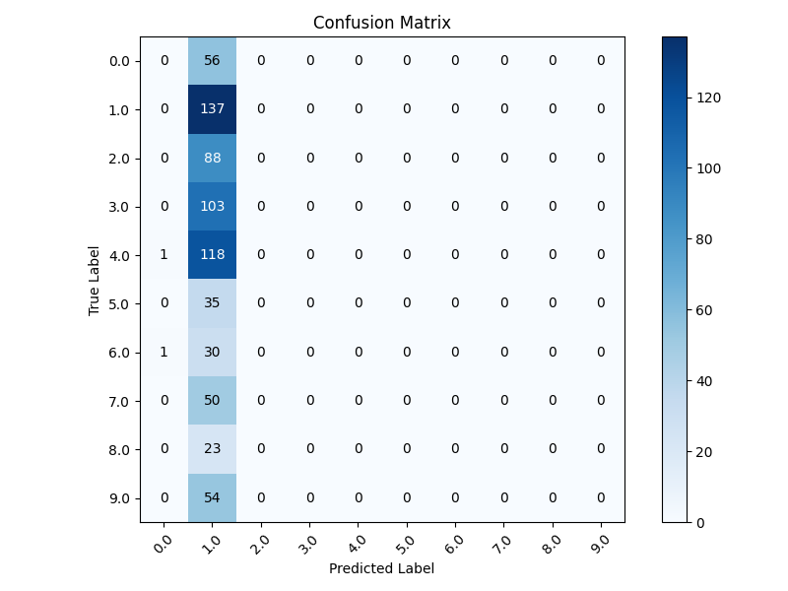
4:- LSTM:-
Accuracy: 0.20 Precision: 0.04 Recall: 0.20

Slide 13
II:- CNN
accuracy : 58.87
Conclusion:-
From the above analysis of the metrices, I found the best accuracy model for this dataset is Logistic Regression with BOW(Bag of Words) for vectorization .
Its accuracy is :- 79 %
Its precision is :- 80%
Its recall is :- 79%

